Slide 1
Rabindranath Thakur and Kazi Nazrul Islam: A Comparative Analysis
SABBIR AHMED

Slide 2
introduction
Brief overview of Rabindranth Thakur and Kazi Nazrul Islam
Their prominence in Bengali literature
The significance of comparing their contributions

Slide 3
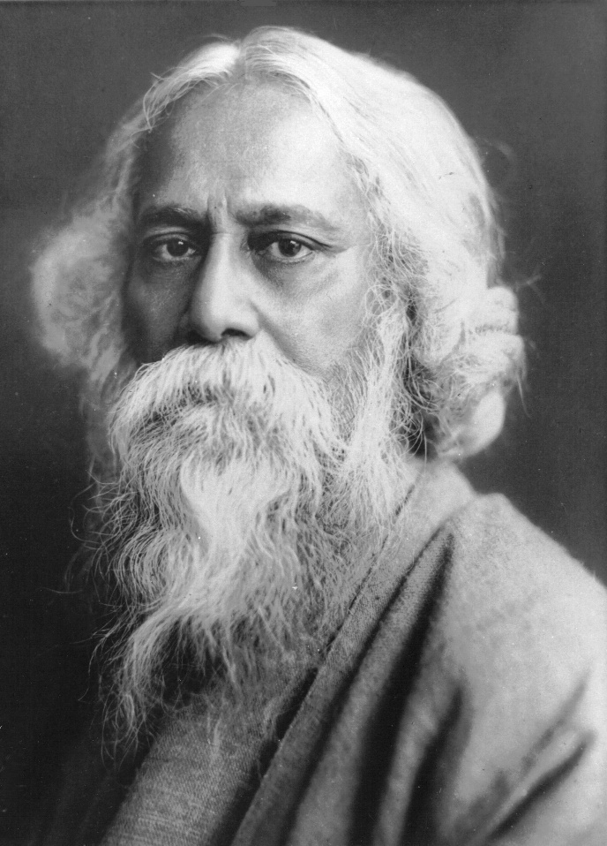
Rabindranath thakur: Early life
Birth: 7 May 1861, Jorasanko Thakurbari, Kolkata
Education and influence of family
Early literary works

Slide 4
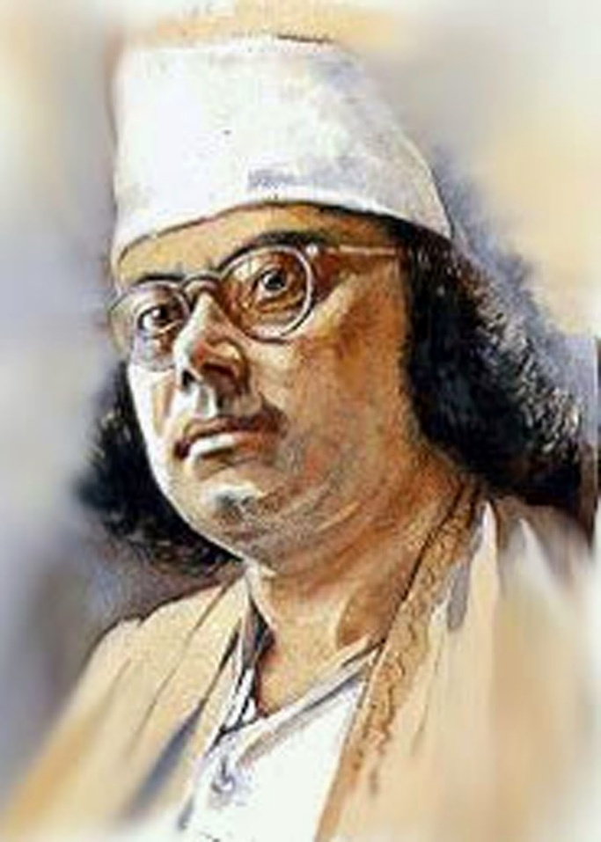
Kazi nazrul islam: Early life
Birth: 24 May 1899, Churulia, Burdawan, West Bengal.
Struggles during childhood.
Early exposure to literature and music

Slide 5
Rabindranath thakur: Literary journey
Major works: Gitanjali, Gora, Chokher Bali, Ghare Baire
Contribution to poetry, novels, and drama
Nobel prize for Literature(1913)

Slide 6
Kazi nazrul islam: Literary journey
Major works: Bidrohi, Agnibina, Bisher Banshi
Themes of revolution and resistnce
Influence of his time in the indian army

Slide 7
Rabindranath’s theme
Focus on humanism, spirituality, and nature
Universal love and harmony
Critique of societal norms

Slide 8
Nazrul’s Theme
Revolution and equality
Anti-colonialism and anti-communication
Advocacy for the oppressed

Slide 9
Rabindranath’s musical contribution
Introduction to Rabindra Songeet
Fusion of classical Indian and Western music styles
Over 2000 songs written and composed

Slide 10
Nazrul’s Musical contribution
Creation of Nazrul Geeti
Themes of rebellion and love in his songs
Blend of classical and folk elements

Slide 11
Rabindranath’s legacy
Contribution to global literature and culture
First non-European Nobel Laureate
Inspiration for subsequent generations

Slide 12
Nazrul’s legacy
Declared the National Poet of Bangladesh
Symbol of rebellion and justice
Influence on modern Bengali music and literature

Slide 13
Comparison of literary styles
Aspect | Rabindranath | Nazrul
Themes | Spirituality, Love | Revolution, Justice
Tone | Serene, Reflective | Fiery, Provocative
Genres | Poetry, Novels, Drama | Poetry, Music, Essays

Slide 14
Conclusion
Summary of their contributions
Their contrasting yet complementary ideologis
Enduring legacy in literature and society

Slide 15
Thank you

